Slide 1

MICRON – HF WASTEWATER TREAMENT
SIMULATION & BENCH TESTING – Dec 2021
Siva Kumar Kota/Chun Yew
Hiep Le/Sankar
Part 1

Slide 2
HFW Treatment Objectives
The objectives of simulation and bench testing are
To identify the optimized flow scheme to treat HFW wastewater
To compare the treatability of the HFW wastewater between Calcium hydroxide and Calcium chloride.
To compare the quantity and quality of generated sludge
To meet sludge quality >80% of CaF2
To meet discharge F<10ppm and TDS <3000 ppm

Slide 3
Simulation summary
Option 1 – NF90/270 + BWRO
Option 1a – NF270 + BWRO (Two Pass)
Option 2 – NF270 + SWRO (Single Pass)
Option 3– NF270 + SWRO (1st pass) + BWRO (2nd pass)
Option 4– NF270 + SWRO (1st stage) + BWRO (2nd stage)
Option 5– NF270 followed by SWRO (clarified water recycle)
Option 5a– NF270 followed by SWRO (separate sludge)
Option 6– NF270 followed by SWRO (F-800 ppm)
Option 6a– NF270 followed by SWRO (F-800 ppm and combined sludge)
Option 6b– NF270 followed by SWRO (F-600 ppm)
Option 7- HFW Effluent treatment
Notes:
600 ppm max
350 ppm avg

Slide 4
Micron 10X – Influent Wastewater quality
Parameters | Unit | HF Wastewater
TDS | mg/L | 698
pH | - | 3.6
TSS | mg/L | 96.0
NH₄ | mg/L | 207
HCO₃ | As CaCO3 mg/L | <20
CO₃ | As CaCO3 mg/L | <20
NO₃ | mg/L | 73.4
SO₄ | mg/L | 174
K | mg/L | 2.92
Na | mg/L | 250
Mg | mg/L | 0.085
Ca | mg/L | 0.20
Sr | mg/L | 0.00041
Ba | mg/L | 0.0016
Cl | mg/L | 25.1
Parameters | Unit | HF Wastewater
F | mg/L | 1136
SiO2 | mg/L | 50.8
B | mg/L | 0.25
Al | mg/L | 0.068
Br | mg/L | 30.3
Cu | mg/L | 0.0028
Fe | mg/L | 0.065
Mn | mg/L | 0.0058
TOC | mg/L | 75.8
O&G | mg/L | <10
PO4 | mg/L | 12.3
COD | mg/L | 280
Total Hardness | As CaCO3 mg/L | 0.85
Total Alkalinity | As CaCO3 mg/L | <20

Slide 5
^{Option1 - NF90/270 + BWRO}
reject
F: 150 m3/hr
F:1136 mg/l
PO4: 100 mg/l
NF
F: 105 m3/hr
F:404 mg/l
PO4: 0 mg/l
BWRO
F: 90 m3/hr
F:30 mg/l
PO4: 0 mg/l
F: 85 m3/hr
F:<10 mg/l
PO4: 0 mg/l
Polishing Filters
UF
HF WW
Treated Water
F: 61 m3/hr
F:3957 mg/l
PO4: 355,2 mg/l
Coagulation, Clarifier
sludge
5
Notes:
NF/RO –projections
FBR –Reject treatment
Npv calculations

Slide 6
Simulation summary
Performed different simulations/projections for the scheme UF, NF & RO scheme
UF:
WW contains high amount of TSS (96 mg/l) and TOC (>50 mg/l).
Achieved recovery ~84% at 41 LMH
NF & RO:
Tried different types of membranes (tighter vs loose membrane)
WW contains high amount of F (1136 mg/l) and Phosphate (100 mg/l).
Tighter membrane:
Phosphate rejection>99.5%
Fluoride rejection~70%
Loose membrane:
Phosphate rejection>99.5%
Fluoride rejection : 30-40%
Overall system recovery ~72%
6
Notes:
NF/RO –projections
FBR –Reject treatment
Npv calculations

Slide 7
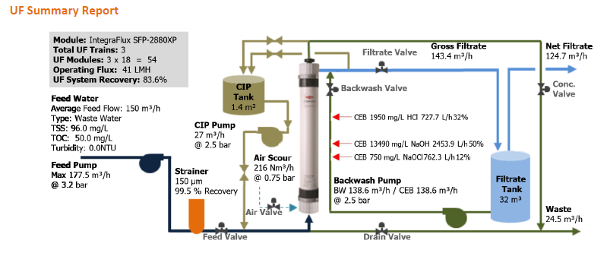
UF Projections
NF
RO

Slide 8
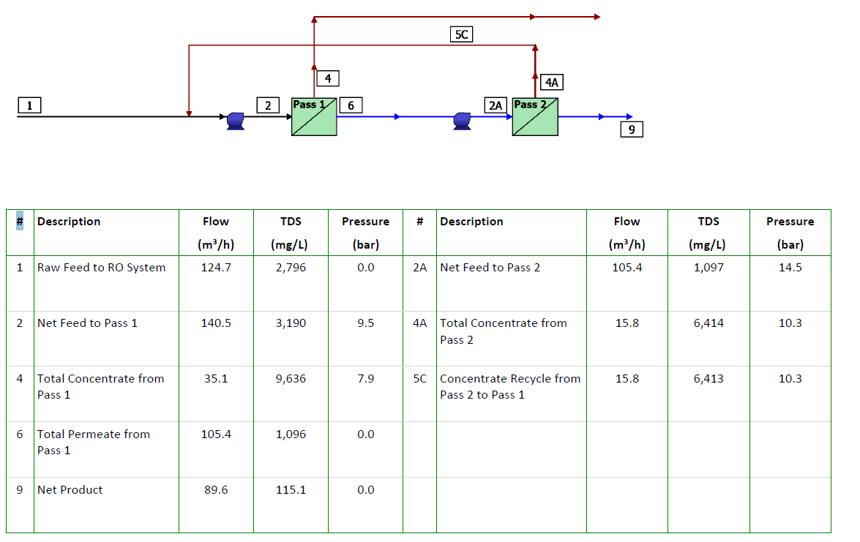
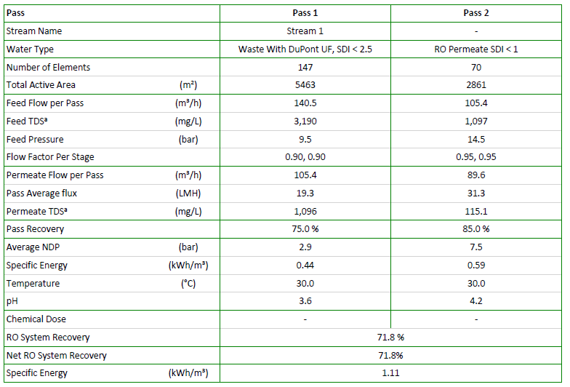
NF & RO Projections
NF
RO

Slide 9
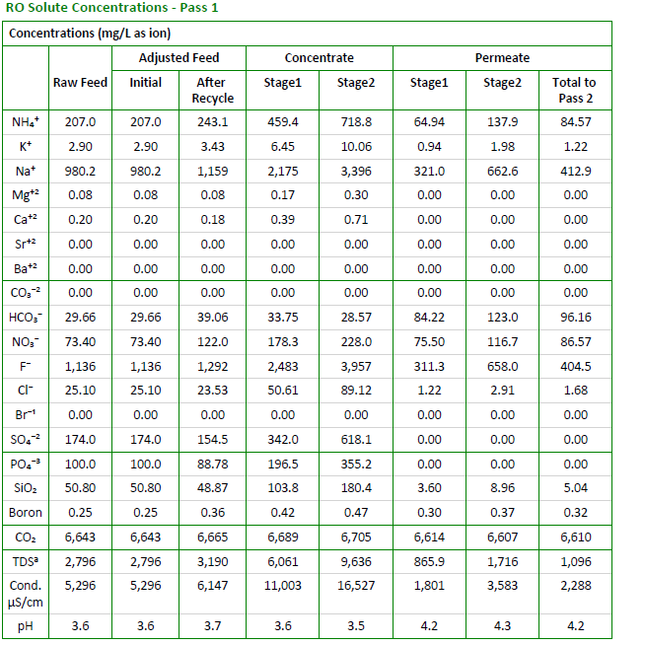
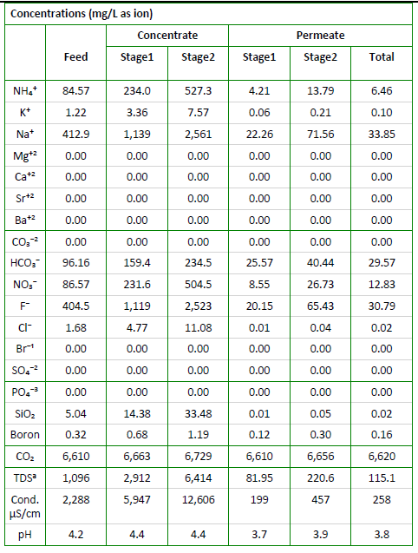
NF & RO Projections Contd.,
NF – Tighter membrane
BWRO

Slide 10
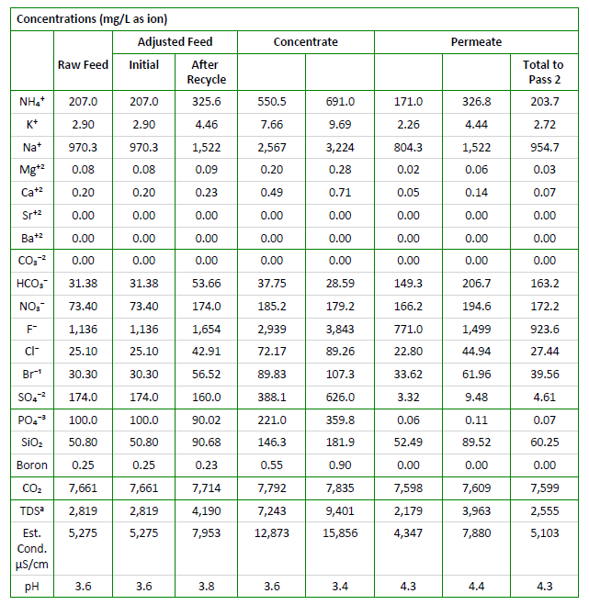
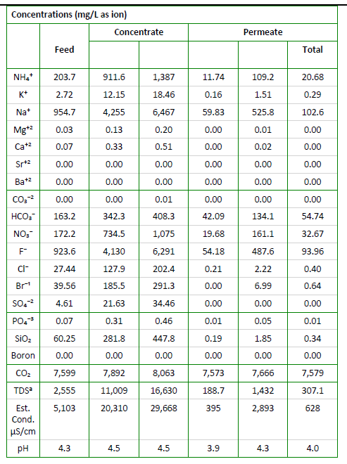
NF & RO Projections Contd.,
NF – Loose membrane
BWRO

Slide 11
Option1a - NF270 + BWRO (Two Pass)
reject
F: 150 m3/hr
F:1136 mg/l
PO4: 100 mg/l
NF270
BWRO (2 pass)
Polishing Filters
Treated Water
UF
HF WW
Coagulation, Clarifier
sludge
11
Notes:
NF/RO –projections
FBR –Reject treatment
Npv calculations
SWRO – 1 PASS
BWRO -2 PASS
SWRO + BWRO
Treated water BWRO

Slide 12
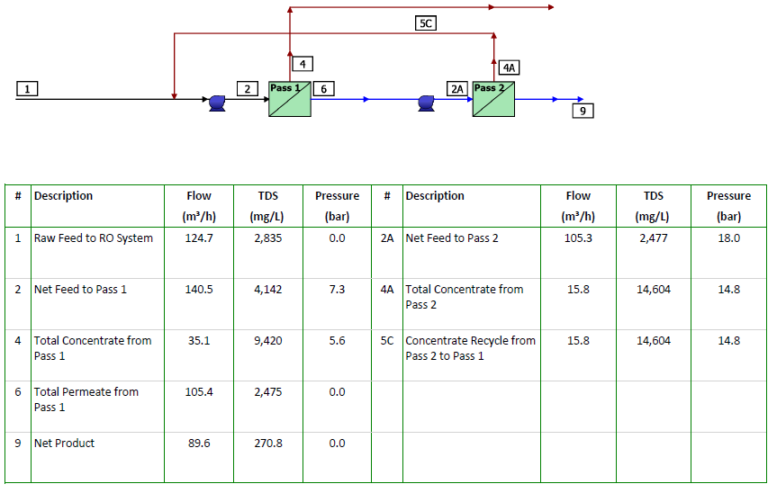
Option 1a – NF270 + BWRO (TWO Pass)

Slide 13
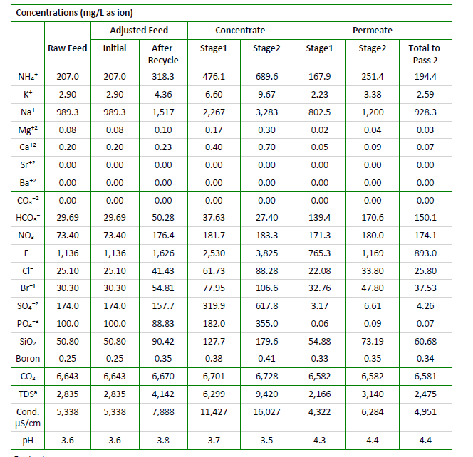
Option 1a – NF270 + BWRO (TWO Pass)
NF 270– Loose membrane

Slide 14
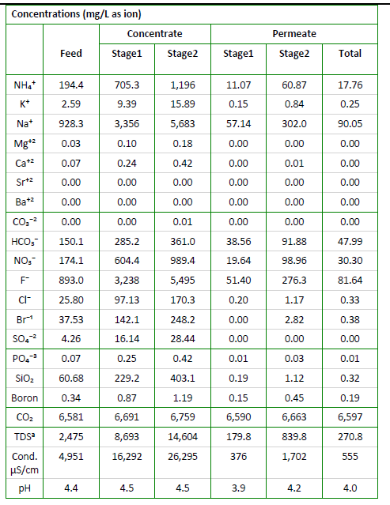
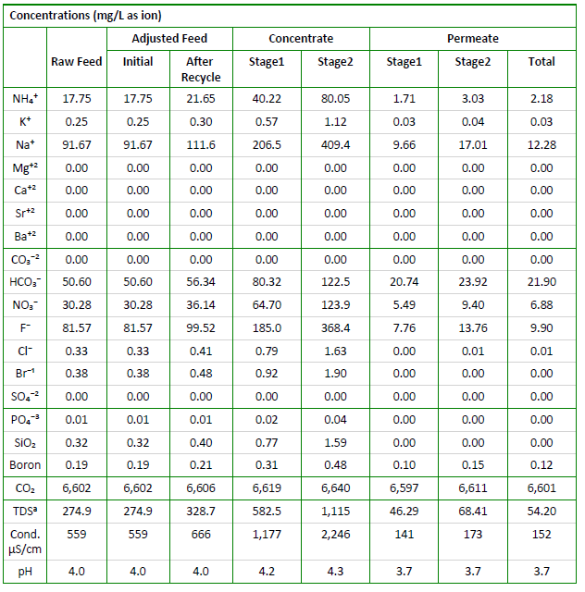
Option 1a – NF270 + BWRO (TWO Pass)
1st Pass BWRO
2nd Pass BWRO

Slide 15
^{Option 2 -} ^{NF270 + SWRO (SINGLE Pass)}
F: 150 m3/hr
F:1136 mg/l
PO4: 100 mg/l
NF270
SWRO
Polishing Filters
Treated Water
UF
HF WW
Coagulation, Clarifier
Coagulation, Clarifier
CaF2 sludge
Phosphate sludge
15
Notes:
NF/RO –projections
FBR –Reject treatment
Npv calculations

Slide 16
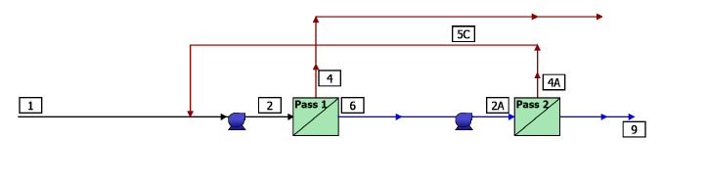
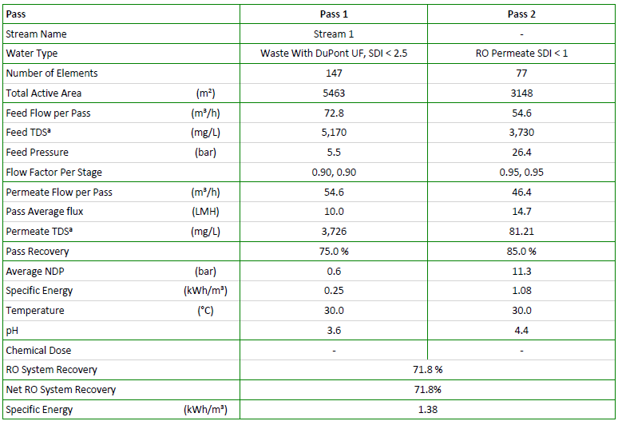
Option 2 – NF270 + SWRO (SINGLE Pass)

Slide 17
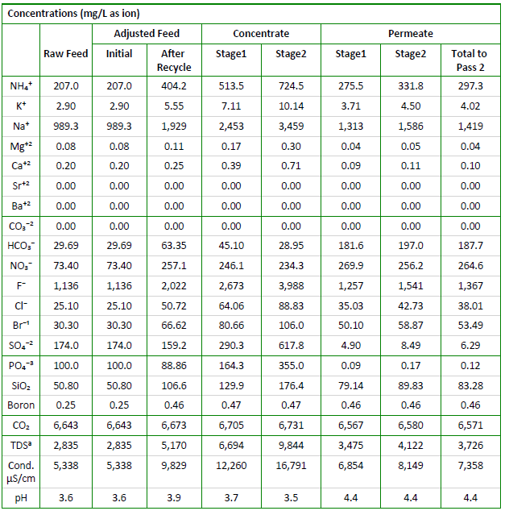
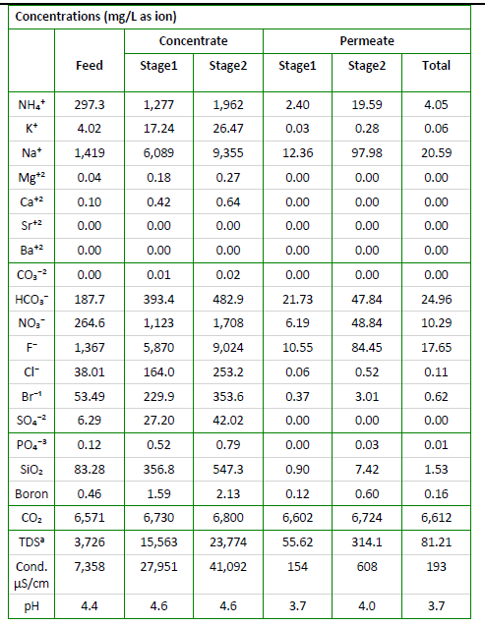
Option 2 – NF270 + SWRO (SINGLE Pass)
NF270
SWRO

Slide 18
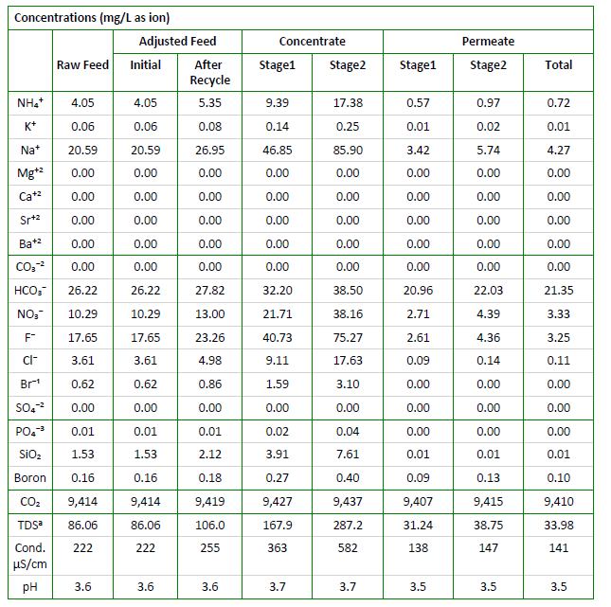
Option 3– NF270 + SWRO (1st pass) + BWRO (2nd pass)
BWRO (2nd pass)
NEWater
Chemical Parameters
Ammonia (as N) | mg/L | <1.0
Aluminium | mg/L | <0.1
Barium | mg/L | <0.1
Boron | mg/L | <0.5
Calcium | mg/L | <20
Chloride | mg/L | <20
Copper | mg/L | <0.05
Fluoride | mg/L | <0.5
Iron | mg/L | <0.04
Manganese | mg/L | <0.05
Nitrate (as N) | mg/L | <5
Sodium | mg/L | <20
Sulphate | mg/L | <5
^{Silica (as SiO}₂⁾ | mg/L | <3
Strontium | mg/L | <0.1
Total Trihalomethanes Ratio | - | <0.04
Total Organic Carbon (TOC) | mg/L | <0.5
^{Total Hardness (as CaCO}₃⁾ | mg/L | <50
Zinc | mg/L | <0.1

Slide 19
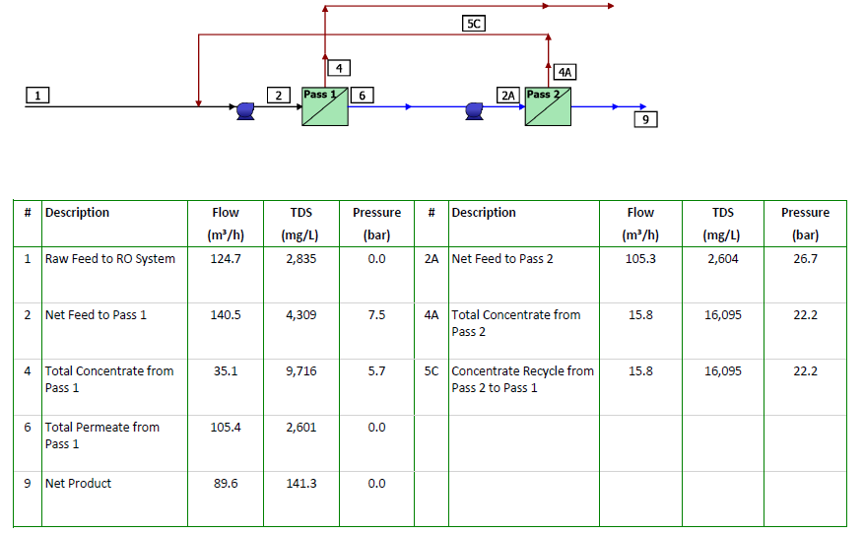
Option 4– NF270 + SWRO (1st stage) + BWRO (2nd stage)

Slide 20
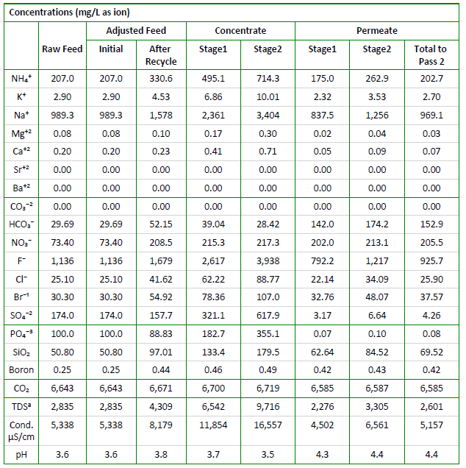
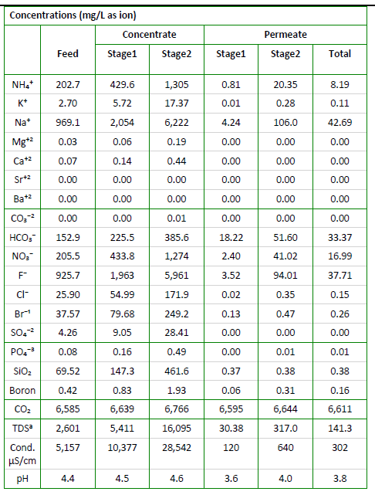
Option 4– NF270 + SWRO (1st stage) + BWRO (2nd stage)
NF270
SWRO (1st stage) + BWRO (2nd stage)

